Slide 1
WGRDBES-StockCoord
Stock Coordination Format (SCF)
22 September 2026

Slide 2
What is the Stock Coordination Format (SCF)
It is the standard exchange format within RDBES for sharing estimates between stock coordinators and stock assessors- replacing InterCatch output files in the future.
Should be compatible with InterCatch
National estimation repositories
Stock estimation repository
Stock assessment repository
National estimator
Stock coordinator
Stock assessor
2020_rdbes.DK
DK
DK
DK
2020_rdbes.SE
SE
CEF
2020_cod.27.21_rdbes.combined
SCF
2020_cod.27.21_assessment
INPUT files
2020_rdbes.DE
DE
InterCatch
CATON, mean weights at age/length, numbers at age/length
Notes:
transformation between InterCatch and RCEF, primarily to support historical data submissions and ease the transition from InterCatch to RDBES.

Slide 3
SCF – where to find things
https://github.com/ices-tools-dev/RDBESstockCoord/tree/main/WGRDBESstockCoord/format/SCF

Slide 4
Two Main Components
 | InterCatch | RDBES
Assessment input | caton.txt canum.txt weca.txt | SCF: Catch, Combined (CC) Age/Length/Width Distribution, Combined (DC)
Quality control and allocation information | AllocationOverviewForPivot_XXX.txt AllocationAndCatchesData.txt DiscardAllocations.txt CatchAndSampleDataTables;txt | SCF: Catch Allocation Setup Distribution Allocation Setup

Slide 5
1. Assessment input
 | InterCatch | RDBES
Assessment input | caton.txt canum.txt weca.txt | SCF: Catch, Combined (CC) Age/Length/Width Distribution, Combined (DC)
Quality control and allocation information | AllocationOverviewForPivot_XXX.txt AllocationAndCatchesData.txt DiscardAllocations.txt CatchAndSampleDataTables;txt | SCF: Catch Allocation Setup Distribution Allocation Setup

Slide 6
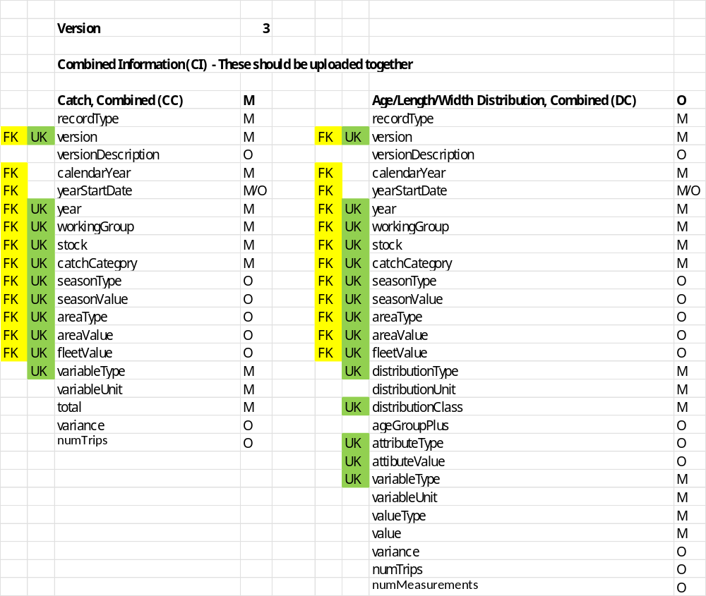

Slide 7
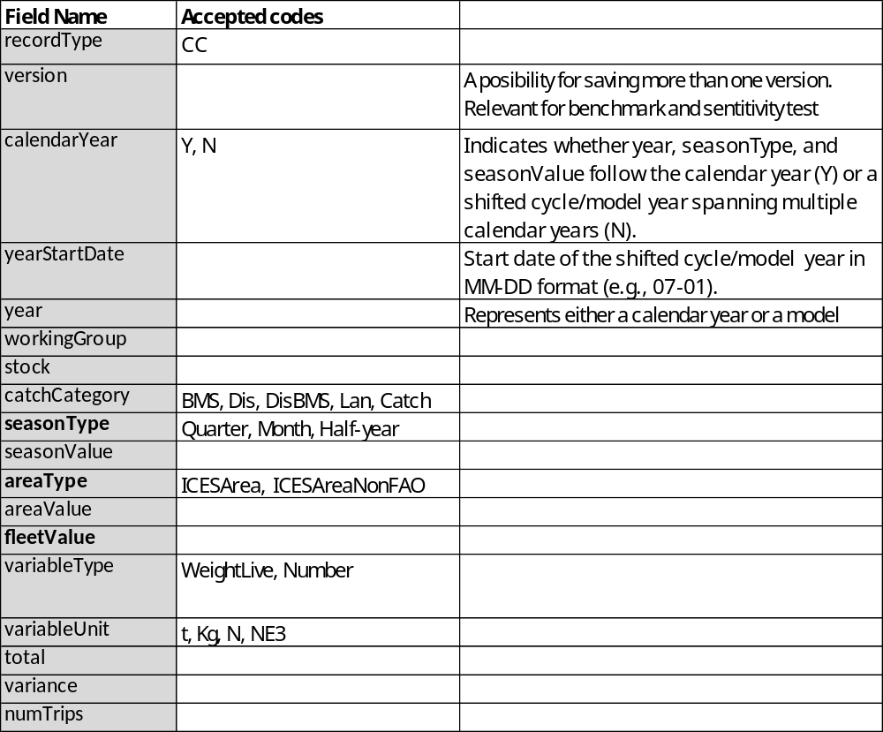
CC
Version & versionDescription
Add after June 2026
E.g.,
  1, Single fleet
  2. multi fleet
The assessement input can be split by:
ICES Area or fisheries management unit
Quarter, Month, Half-year
Fleet

Slide 8
CC, continued
Model year vs. calendar year
For some stocks, the year is shifted to better reflect the stock’s life cycle.
The “birthday” is moved from 1 January to another date, changing age assignment.
E.g. spr.27.3a4: birthday = 1 July → model year runs Q3–Q2.
As ages are reassigned during stock coordination, estimates should use model year + season, not calendar year + season.

Slide 9
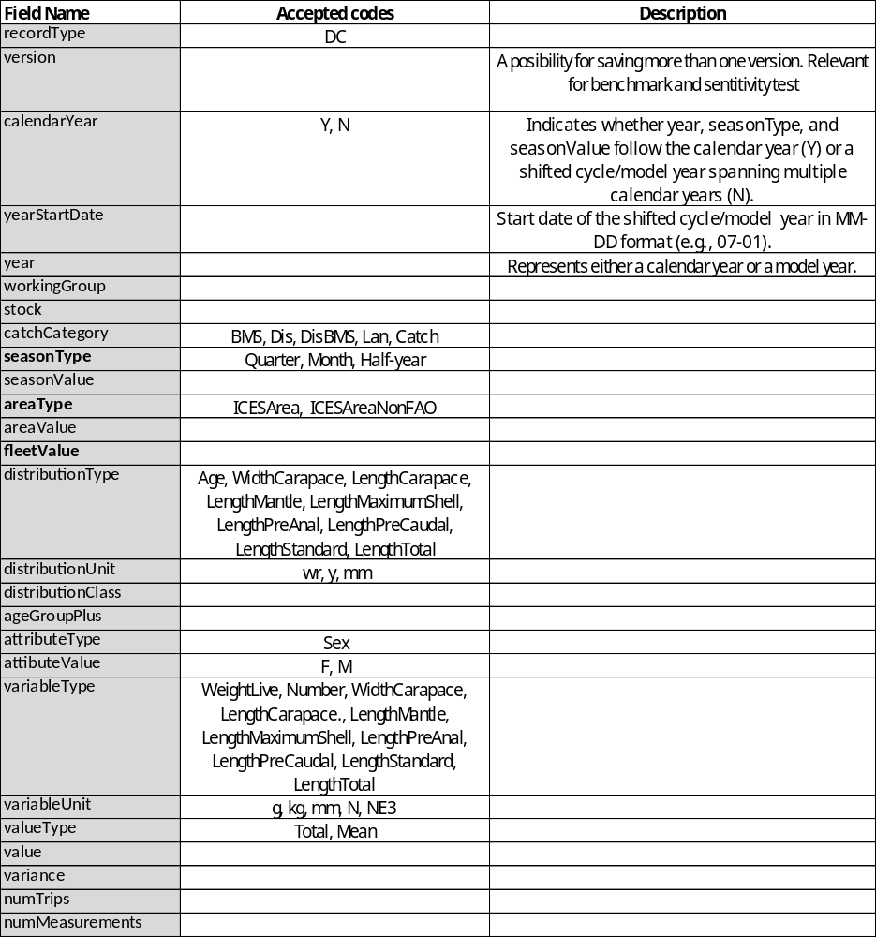
DC

Slide 10
Example with calendar year
Example with model year

Slide 11
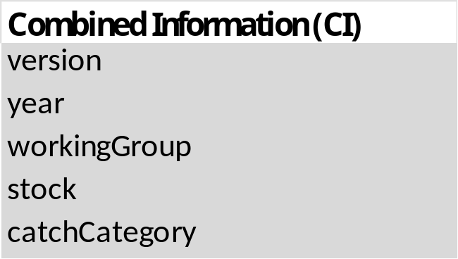
Overwriting rules
Notes:
Defined at a higher level and not based on the Uks because of the high risk of duplication

Slide 12
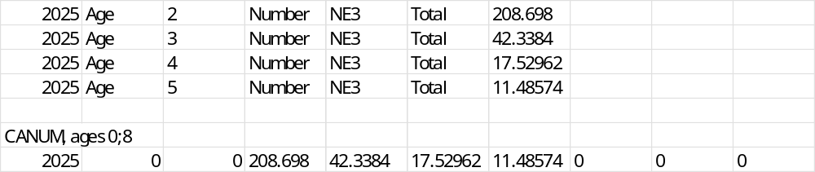
From SCF to model input
We need a function for transposing the suggested SCF into the wide format that a lot of stock assessment models use

Slide 13
Known issues
Counts (numTrips, numMeasurements)

Slide 14
2. Allocation information
 | InterCatch | RDBES
Assessment input | caton.txt canum.txt weca.txt | SCF: Catch, Combined (CC) Age/Length/Width Distribution, Combined (DC)
Quality control and allocation information | AllocationOverviewForPivot_XXX.txt AllocationAndCatchesData.txt DiscardAllocations.txt CatchAndSampleDataTables;txt | SCF: Catch Allocation Setup Distribution Allocation Setup
Aim: document how catch allocation and distribution allocation were performed in RDBES, while also supporting the documentation of historical allocations carried out in InterCatch

Slide 15
SCF - extended
The SCF is extended with two additional table pairs:
Catch Allocation Setup (discard raising)
Distribution Allocation Setup (age/length allocation)

Slide 16
SCF - extended
Upper section
sampled strata and allocation results
total calculation and aggregation overview
Each table pair consists of
two sections:
Lower section
sampled strata
sampled strata listed by allocation group
Simple option
grouped strata
Detailed option
grouped strata and additional information

Slide 17
SCF - extended
Upper section
sampled strata and allocation results
Catch Allocation Setup – Catch Allocation Results (CAR)
Distribution Allocation Setup – Distribution Allocation Results (DAR)
Each table pair consists of
two sections:
Lower section
sampled strata
Catch Allocation Setup – Catch Allocation Sources (CAS)
Distribution Allocation Setup – Distribution Allocation Sources (DAS)
Simple option
grouped strata
Detailed option
grouped strata and additional information

Slide 18
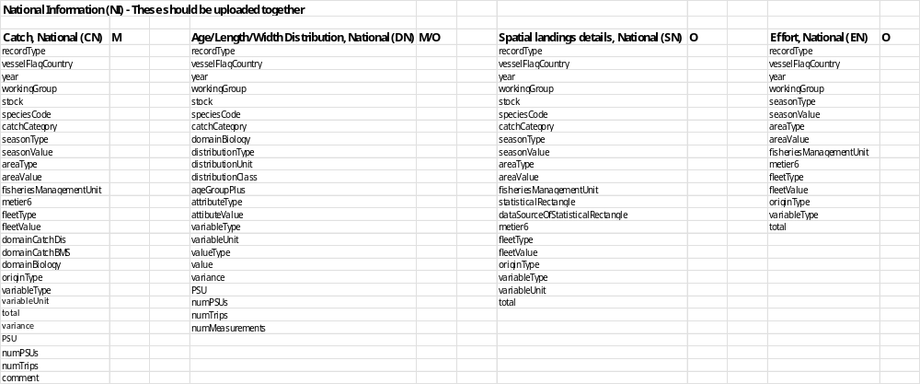
2. Allocation information
2.1 Catch Allocation Setup – Upper section (CAR)
CEF – 4 tables

Slide 19
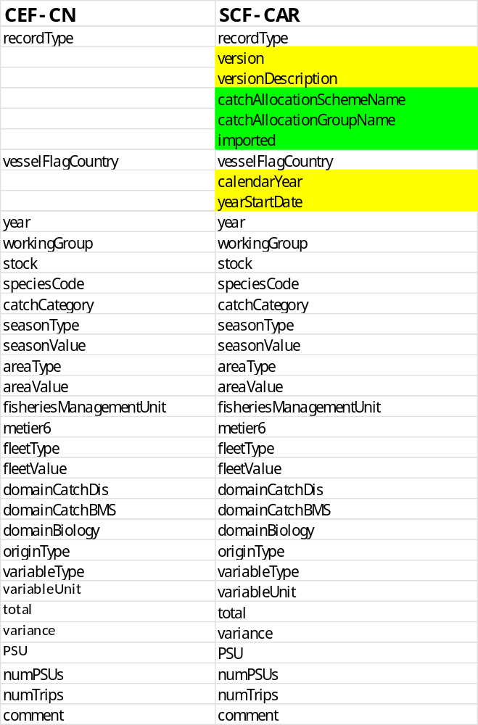
2. Allocation information
2.1 Catch Allocation Setup
– Upper section (CAR)
This table is based on CEF CN, with additional fields:
Yellow: following the specification of the SCF
Green: new fields
  catchallocationSchemeName
  catchallocationGroupName
  imported

Slide 20
2. Allocation information
2.1 Catch Allocation Setup
– Upper section (CAR)
  catchallocationSchemeName: identifies the allocation scheme used
  catchallocationGroupName: identifies the allocation group to which sampled strata belong
  imported: A Y/N indicator specifying whether a stratum was imported. Only for records where imported = N, the catchallocationGroupName is filled)

Slide 21
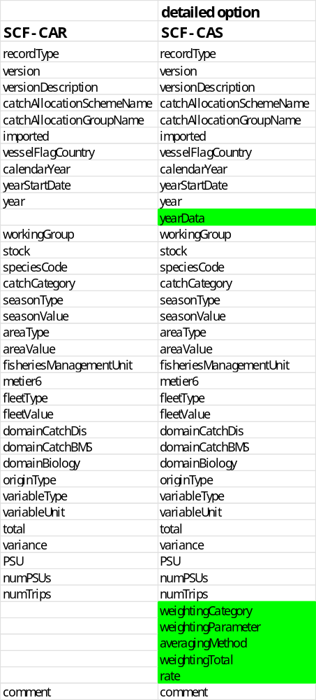
2. Allocation information
2.1 Catch Allocation Setup
– Lower section (CAS)
– Detailed option
This table is based on SCF CAR, with additional fields (green):
  yearData
  weightingCategory
  weightingParameter
  averagingMethod
  weightingTotal
  rate

Slide 22
2. Allocation information
2.1 Catch Allocation Setup
– Lower section (CAS)
– Detailed option
  yearData: year to which the data refer (may differ from the processing year when data from a previous year are used for allocation)
  weightingCategory: LAN, DIS
  weightingParameter: WeightLive, Number
  weightingTotal: total value of the specified weightingCategory and weightingParameter
specifies the dataset from which the weighting values are taken

Slide 23
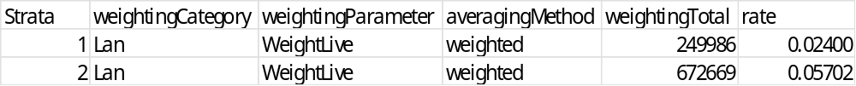
2. Allocation information
2.1 Catch Allocation Setup
– Lower section (CAS)
– Detailed option
  rate: the discard-to-landings ratio (Discard / Landings) for the matched discard–landing stratum, calculated from domainCatchDis
  averagingMethod: determines how the discard rate (rate) is calculated when multiple matched discard–landing strata are grouped in the same allocation group.
    Weighted – each matched discard–landing stratum contributes to the final discard rate in proportion to its weightingTotal
    Equal – all matched discard–landing strata contribute equally to the final discard rate, regardless of their weightingTotal.
InterCatch : Landing CATON

Slide 24
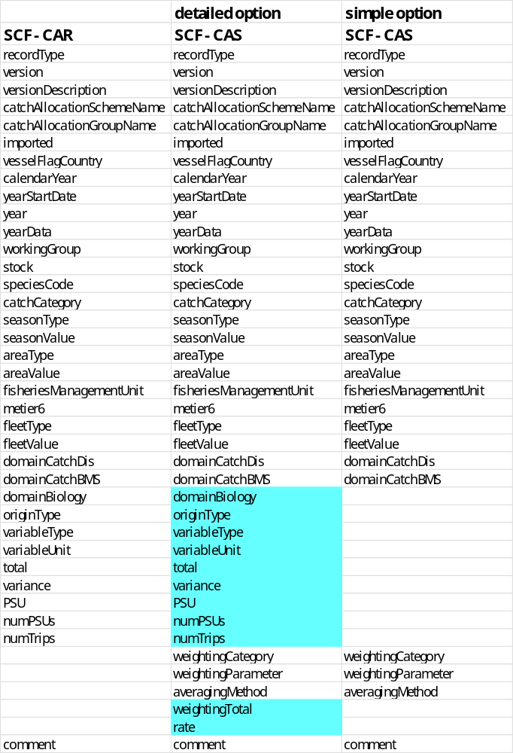
2. Allocation information
2.1 Catch Allocation Setup
– Lower section (CAS)
– Simple option
This table is a reduced version of the SCF CAS detailed option, with exclusion of the blue fields

Slide 25
2. Allocation information
2.2 Distribution Allocation Setup – Upper section (DAR)
CEF – 4 tables

Slide 26
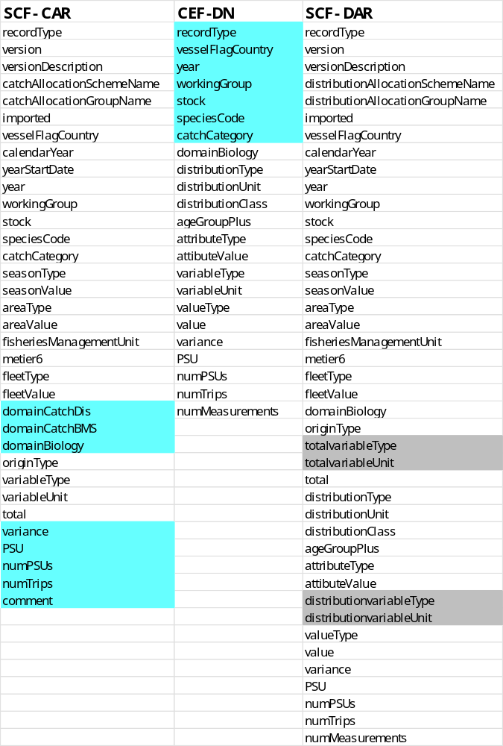
2. Allocation information
2.2 Distribution Allocation Setup
– Upper section (DAR)
This table combines the SCF CAR with information from CEF DN, with exclusion of the blue fields and renaming of the fields variableType and variableUnit

Slide 27
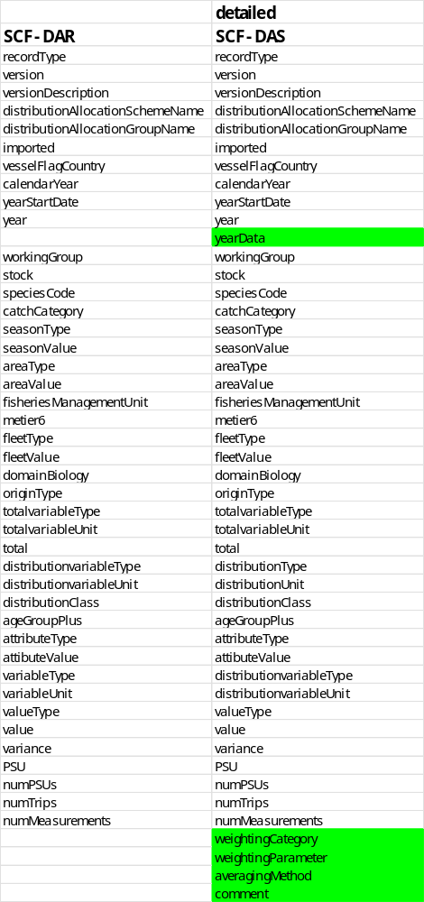
2. Allocation information
2.2 Distribution Allocation Setup
– Lower section (DAS)
– Detailed option
This table is based on SCF DAR, with additional fields (green):
  yearData
  weightingCategory
  weightingParameter
  averagingMethod
  comment

Slide 28
2. Allocation information
2.2 Distribution Allocation Setup
– Lower section (DAS)
– Detailed option
  yearData: year to which the data refer (may differ from the processing year when data from a previous year are used for allocation)
  weightingCategory: LAN, DIS
  weightingParameter: WeightLive, Number
specifies the dataset from which the weighting values are taken

Slide 29
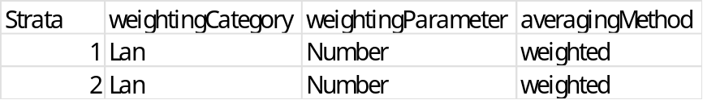
2. Allocation information
2.2 Distribution Allocation Setup
– Lower section (DAS)
– Detailed option
  averagingMethod: determines how the distribution is calculated when multiple sampled strata are grouped in the same allocation group.
    Weighted – each sampled stratum contributes to the final distribution in proportion to its weightingParameter
    Equal – all sampled stratua contribute equally to the final distribution contribute to the final distribution, regardless of their weightingParameter
InterCatch : Mean weight weighted by numbers at age or length

Slide 30
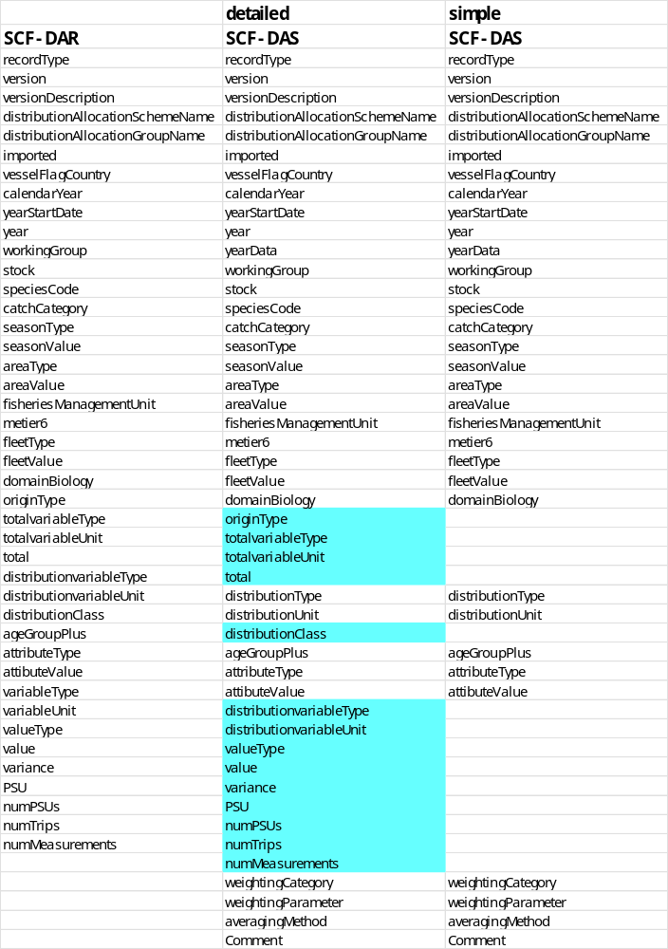
2. Allocation information
2.2 Distribution Allocation Setup
– Lower section (DAS)
– Simple option
This table is a reduced version of the SCF DAS detailed option, with exclusion of the blue fields

Slide 31
Summary
The upper tables includes all strata, also sampled
  Provides a complete overview of all strata, allowing totals to be calculated and aggregated for quality checks
What version do you prefer?
  Catch allocation: Detailed or simpel
  Distribution allocation: Detailed or simpel
Should all tables be mandatory? What if the stock coordination functions are not used or you start from the raw RDBES data?)
What about SOP corrections?

